Slide 1



North Retail Analysis
View in Power BI
Last data refresh:
11/1/2023 4:49:59 PM UTC
Downloaded at:
11/4/2023 2:56:52 PM UTC

Slide 2
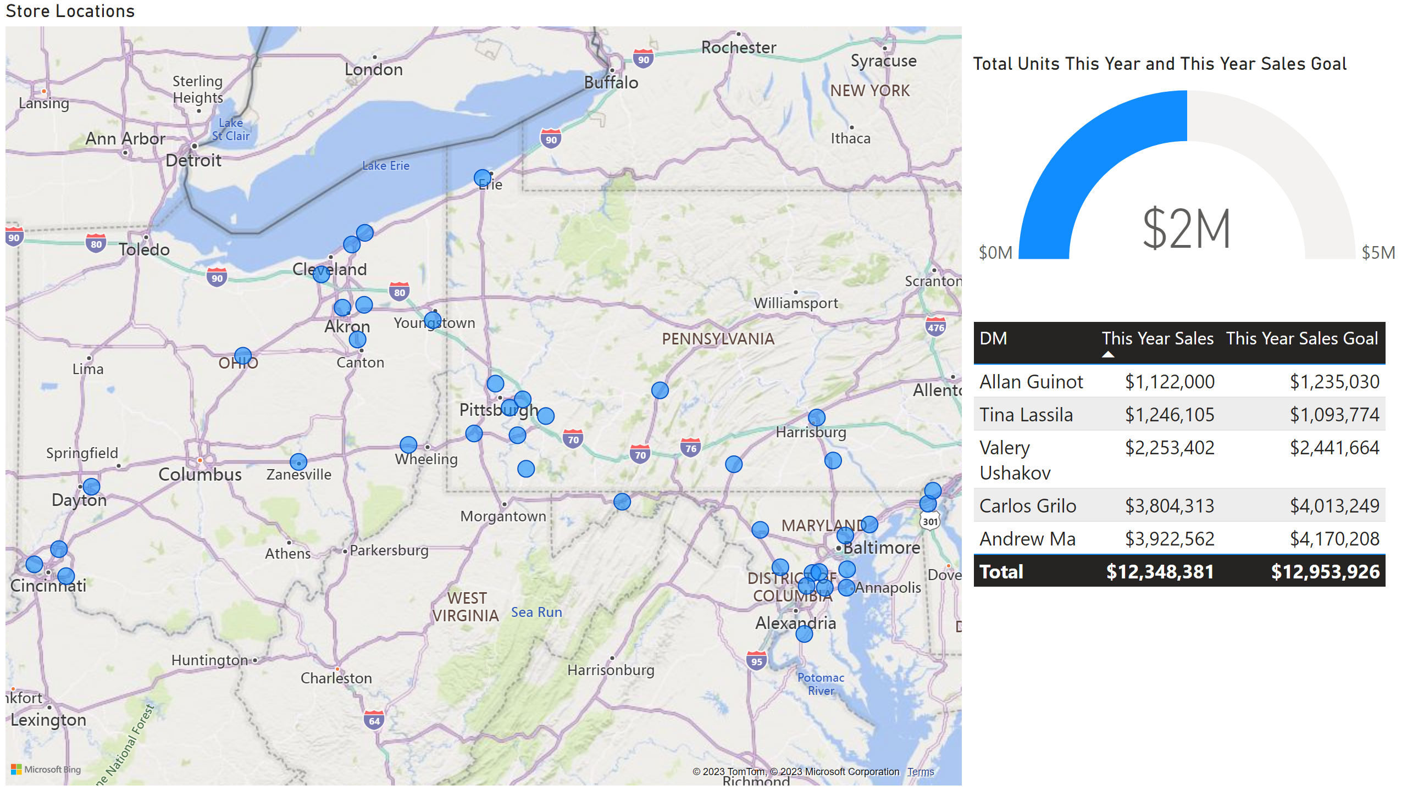
Overview
Notes:
tableEx
No alt text provided
Store Locations
No alt text provided
gauge
No alt text provided

Slide 3
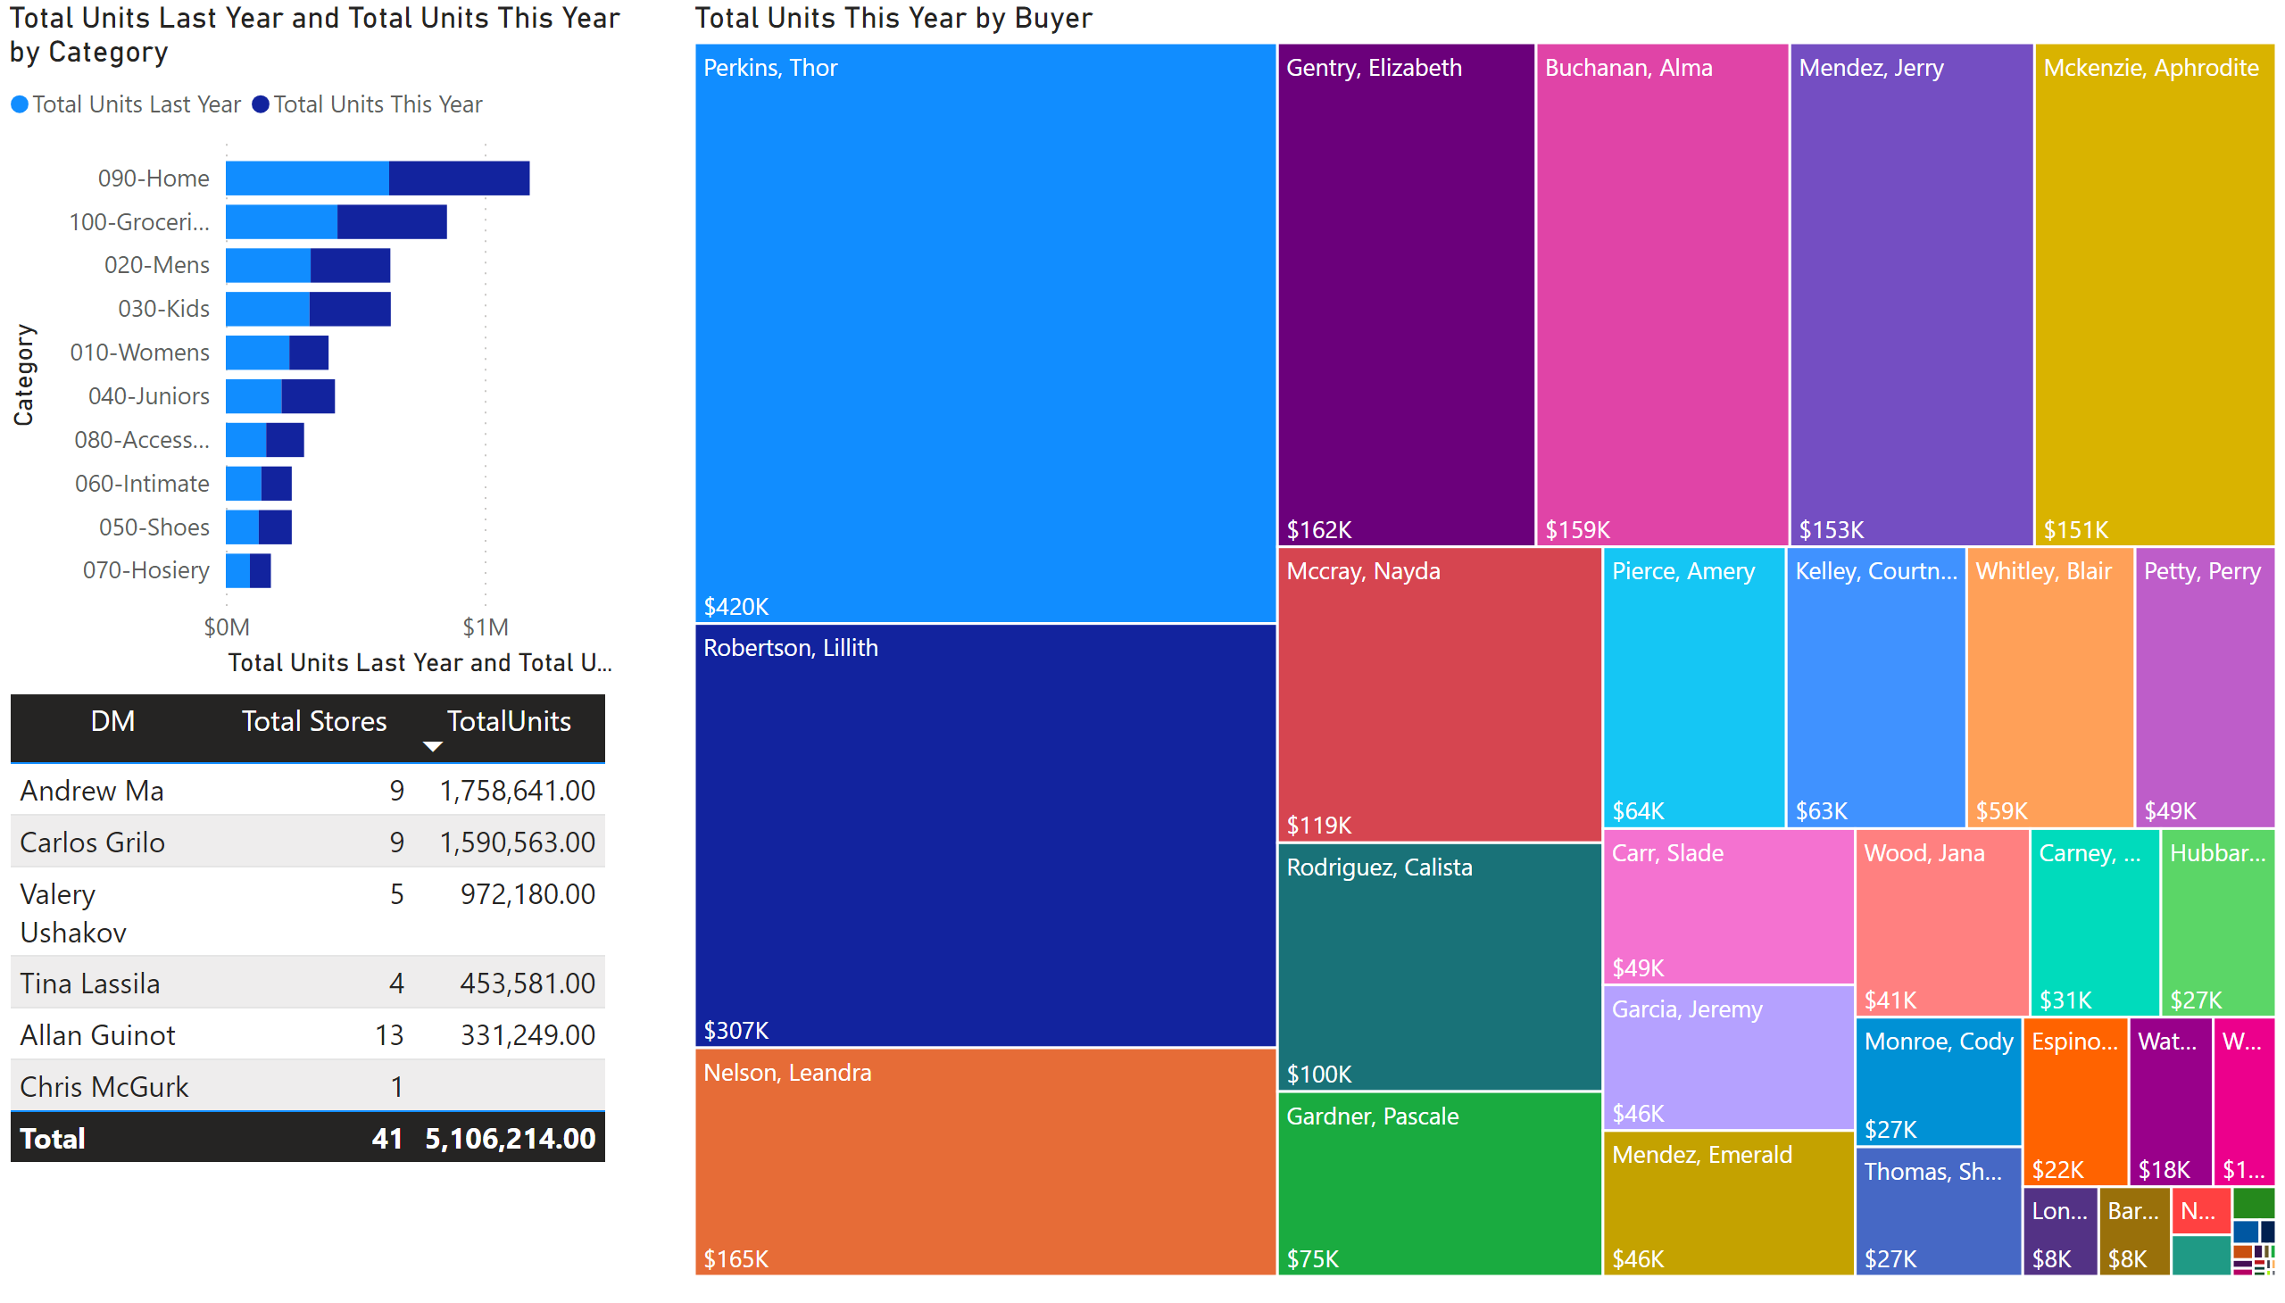
Category and Buyer
Notes:
treemap
No alt text provided
barChart
No alt text provided
tableEx
No alt text provided

Slide 4
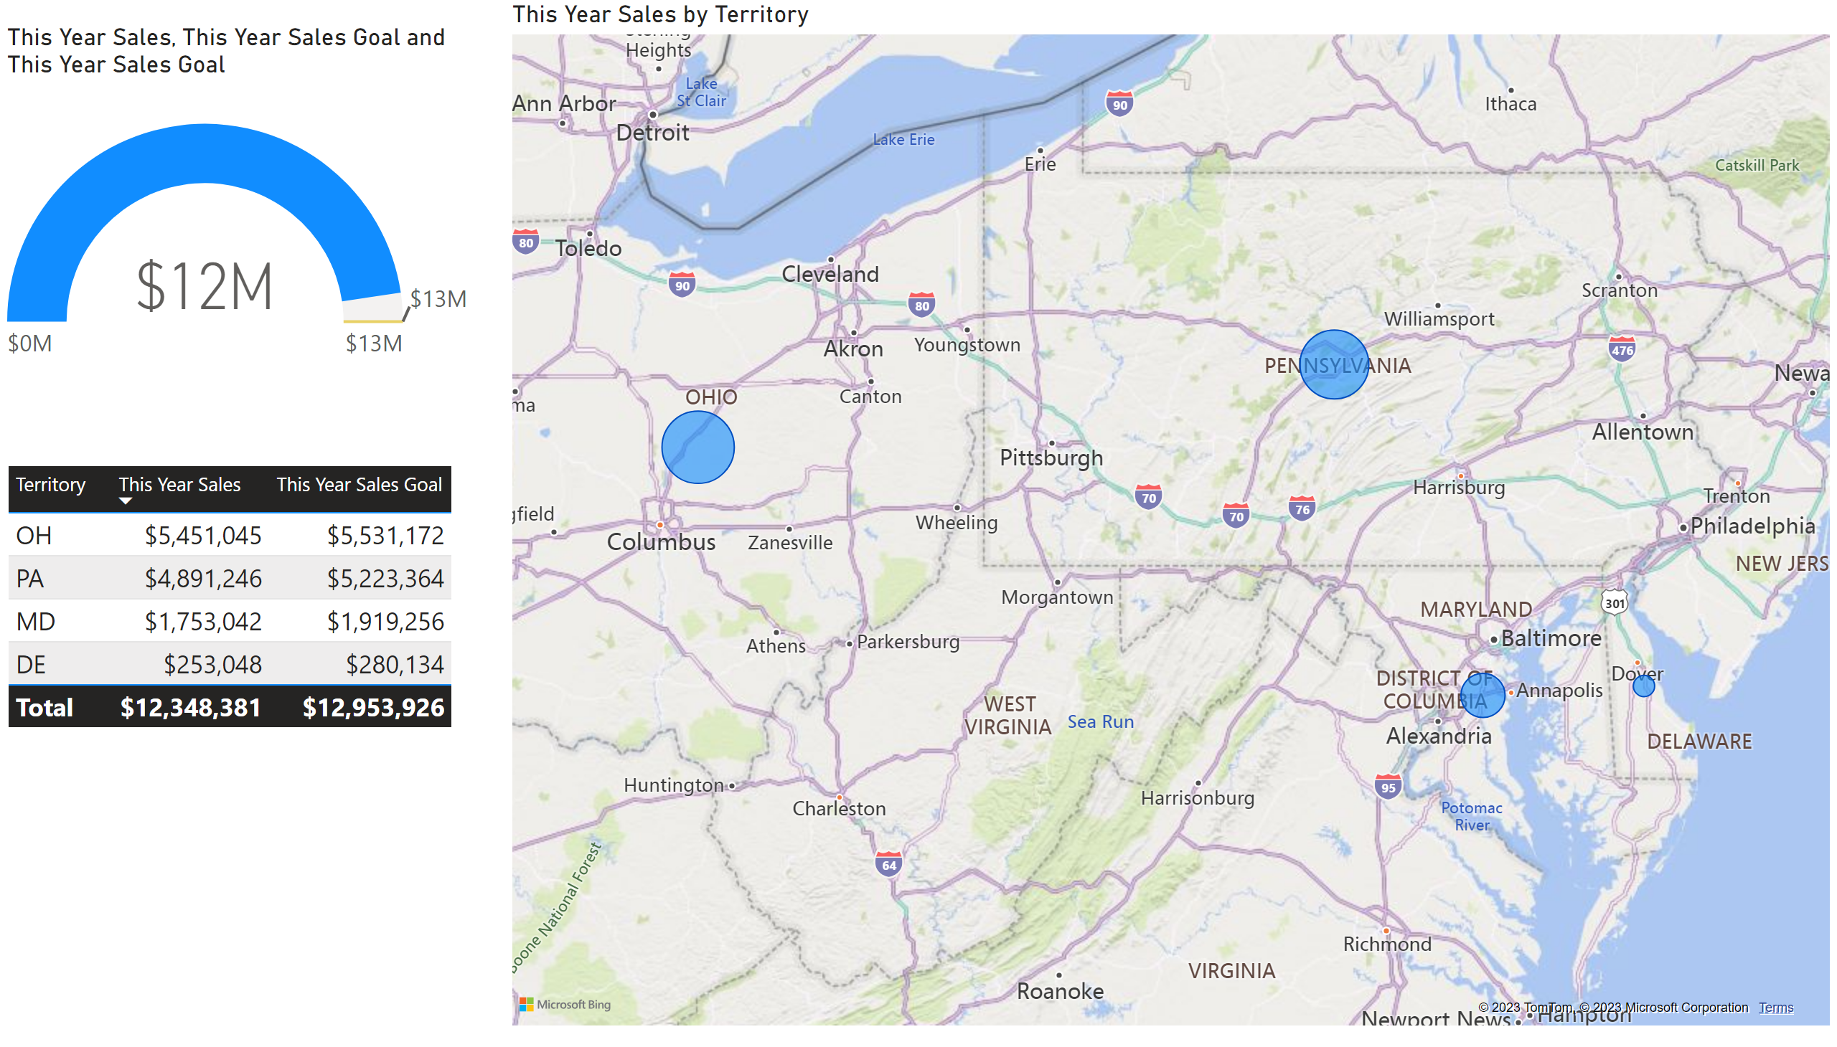
Territory
Notes:
gauge
No alt text provided
map
No alt text provided
tableEx
No alt text provided

